Slide 1
RAFT Data Strategy
V 0.1 2020-06-29

Slide 2
Contents
Summary
Objective
Current State
Target state
Types of data
Data principles
Understanding data linage
Appendices
RAFT Project Principles
Group Architecture Principles

Slide 3

Summary
In the current state each office uses different data technologies that run on-prem
TOM underestimated the size and complexity of building our own global data layer
Our RAFT target state is to:
Outsource as much of the data management and distribution process as possible to our chosen outsource partners
Maintain a cloud-based data source and self-service analysis toolset for the AAM community
We will apply 5 principles when we evaluate vendor offerings and technical solutions for data architecture compliance
We need to fully document our data linage to understand what each partner will maintain
Front Office Outsource Partner(s)
trades
Back Office Outsource Partner(s)
Data lake
API calls
EUC Model
BI Tools

Slide 4
AAM Current State (maybe take this out)​
Current State​ | TOM Project​
Data is managed separately by each office​ There is no consistency in data structure or definition other than for industry recognized data attributes (e.g. ISIN)​ All market data vendor contracts are controlled by Vendor Management​ Each office has adopted a different data integrity checking, transport and storage toolset (e.g. NL = Communications Bus, US = Informatica, UK = SSIS)​ Each office has adopted a different data warehouse and reporting toolset (NL=AMIS, US=IDW, UK=IDB)​ | Deadlines were too ambitious for the size of the task​ The role of the internal data manipulation toolset (MEDM) vs Cloud based tools (AWS Glue) were not clear enough​ The AWS learning curve was not factored in​ Build-out strategy (e.g. taking one of the existing data warehouses and building it out to become the global data warehouse) proved to be too complex ​ Buying a tool (Collibra) does not deliver master data governance; the size of the implementation task was underestimated​ Not enough experienced data analysts​

Slide 5
Emerging Market Trends
Under project Raft we will assess the maturity and cost effectiveness of the services in the emerging outsource capabilities. For the data strategy this impacts our Data Distribution and Traditional Warehouse capabilities
Organisational Competence | High | Contain (emerging outsource) | Strategic (in-house)
 | Low | Support (commodity) | Emerging (partner)
 |  | Low | High
 |  | Strategic Impact
US GA Accounting
Risk Analytics
Historical Data & BI
Sales & Marketing
Commitment Based Investment
Data Distribution
Performance Measurement
Liquid Investment
Direct Investment
NL GA Accounting
Trading
Client Reporting
Data Insights (Analytics)
UK GA Accounting
Fund Accounting
Cloud

Slide 6
Objective
Improve the way we capture, store, manage, share and use data
Capture
Outsource partners capture the data their platforms need
Partners store the data their outsourced function needs
Store
Business steers data priorities
Data Management becomes an oversight function and not a core business capability
Manage
Data enables the business
Data lake is the single place where we consolidate data from partners
Share
We lever advanced AI and analytics for cross function data analysis
Use

Slide 7
Current State (Need a picture of current state)
Each office has pursued its own data strategy and adopted different tools
Office | Capture | Store | Manage | Share | Use
US | Information Markit EDM | Oracle MS SQL Server | Separate Data Management Team check data integrity | Informatica MS Access Control M | Business Objects
NL | Markit EDM | Oracle MS SQL Server | Separate Data Management Team check data integrity | Home grown Communications Bus GECS | Business Objects
TKPI | Markit EDM End user computing | MS SQL Server | Separate Data Management Team check data integrity | End user computing | End user computing
UK | Markit EDM | MS SQL Server | Separate Data Management Team check data integrity | MS SQL Server Integration Services | MS SQL Server Reporting Services
Conclusion | No market data collection standard pattern Markit EDM’s are each configured differently | Different data structures and technologies NL use Oracle for SimCorp Dimension | Data governance is local | Batch based data transfer dependence Different tools in each office | Disparate technologies

Slide 8





Target State 1/2
Office | Capture | Store | Manage | Share | Use
Global | Chosen vendors capture the data requested by AAM | Chosen vendor operational platform(s) Data lake populated by vendor(s) Transformation to hold in time series | Oversight of vendor data quality | API’s to access vendor data stores File extracts from data lake | AWS Data Labs Reports provided by vendor platforms
Indices
Front Office Outsource Partner(s)
Corporate actions
Data Labs
Prices
Data Governance
Back Office Outsource Partner(s)
Custodian Statements
Data Lake
BI Tools

Slide 9
Target State 2/2
325 applications +
299 EUC models
Current
Future
18%
1%
81%
Outsource - SaaS
PaaS
In-house – Commercial Packages
Outsource - SaaS
PaaS
In-house – Commercial Packages
SaaS, Software as a Service, where the application, technical services and hardware are managed by the vendor​
PaaS, Platform as a Service, where we manage the application on a cloud vendor’s technical services and hardware​
IaaS, where we manage the application and technology services on a vendor’s hardware​

Slide 10
Types of data (What about client data etc)
Data usage varies as it flows through the value chain
IBOR
ABOR
Lake
Provider | Front Office Partner(s) | Back Office Partner(s) | Home grown - AWS technologies
Function | Investment book of records | Accounting book of records | Raw data pool
Audience | Front Office & Risk | Operations | Business Intelligence
Type | Traded positions | Settlement positions | Unstructured (big) data
Purpose | Allows portfolio managers to see their portfolio start of day holdings & cash and real time changes as decisions are made | Allows AAM to prove its compliance with regulations and accounting standards | Allows IM professionals to consume data for their own analysis
Features | Real time position updating | Calculates NAV according to rules (e.g. UCITS, IFRS) | Unstructured data objects
Timeliness | T | T+1 | T+1
Coverage | Strategies, Portfolios | Client, Seg. Mandate, Fund & subfund | Any data class
See also appendix 1

Slide 11
Data Principles 1/2
We will add 5 data principles to the already agreed group principles and RAFT project principles
Group Architecture Principles
1 | Accessibility
2 | Transparency & Tractability
3 | Digital native
4 | Privacy & data protection
5 | Standardisation
6 | Sustainability
7 | Trustworthy
8 | Value
9 | Functionality
10 | Agility
RAFT Project Principles | RAFT Data Principles
One global platform
Partners host their own technology | Operational data comes from operational systems
We learn best practice from our partners | Data in cloud, no on-prem data
Fastest time to market | Partners must prove data privacy & protection
Simplify and save | Partners delivery data to our data lake only
Vendor(s) do the work | Cross function data comes from the data lake
See also appendix 2
See also appendix 3

Slide 12
Data Principles 2/2
We will follow the following 5 data principles when we design the RAFT implementation strategy
Principle | Rationale
Operational data comes from operational systems | We are buying outsource services, not commercial off-the-shelf software packages that we own and run We do not want responsibility for software upgrades Vendors manage change projects and not AAM
Data in cloud, no on-prem data | Users have one data source and user interface Access controls are easier to maintain and audit Data is always contextually correct and up-to-date
Partners must prove data privacy & protection | Technology simplification Cost reduction Easier to flex up or down
Partners delivery data to our data lake only | One delivery pattern for all partners Single point for data sources and uses governance Data is in one place
Cross function data comes from the data lake | No need for local data collection from different sources, transformation and merging Data access and privacy is centrally controlled Data usage can be metered (cost control)

Slide 13


Understanding data linage
We need to fully document our data linage. An example, the "transaction" lifecycle
We need to fully document our data linage and page the processes and information objects to the partners and systems that provide the service
Investment Desk
Proposed Order
Pre-trade Compliance
Order
Placement
Block
Trade
Fill
Allocation
Allocation
Aladdin
thinkFolio
Confirmation
Aladdin
SimCorp
Citi
SWIFT Message
Send to Custodian
Settlement Instruction
Enrichment
Financial Accounts
Record Keeping
Confirmed Allocation
Client’s Custodian
PAM
State Street
SimCorp
Citi

Slide 14
Appendices

Slide 15
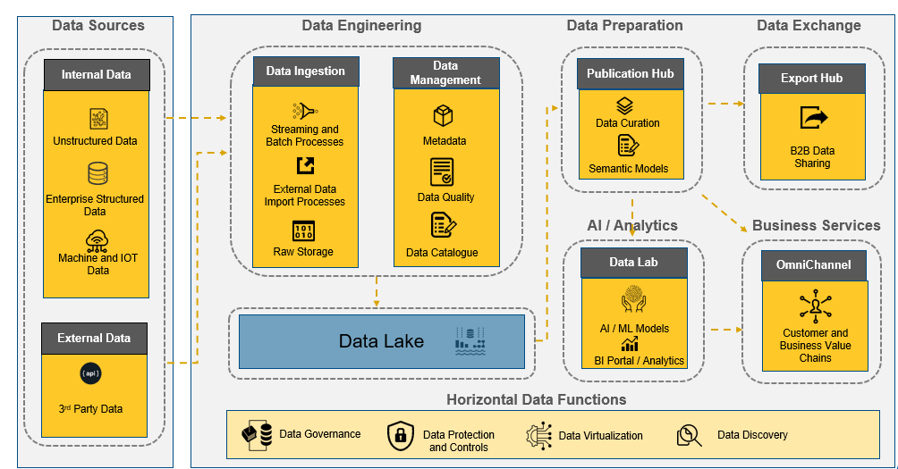
AAM Data Lake
Data Ecosystems: Cloud Data Platform Reference Architecture
Overview
Cloud services to provide elastic scalability
Data is handled and processed in a secure, controlled and compliant manner
Data roles and responsibilities are partitioned according to specific requirements
Enables the use of data to enhance business services, automate internal processes, and maintain a continuous conversation with the customer and the wider market

Slide 16
RAFT Project Principles
We will follow the following 5 principles when we design the RAFT implementation strategy
Principle | Rationale
One global platform | AAM is one global business, all global units will share the same platform To globalise we all accept we must think differently and accept compromise Local deviation will only be allowed when MB approve the exception
We learn best practice from our chosen vendor(s) | Use the chosen vendor’s vanilla platform as much as possible, the vendor’s scale allows them to continuously improve their functionality and keep up-to-date with market best practice When we identify missing functionality we expect the vendor to upgrade the core system; vendor provided AAM customisations, home-grown satellite sub-systems or EUCs are prohibited.
Fastest time to market | Maintain one enterprise-wide transition plan that is easy to understand and align our resources behind Minimise transition stages; to deliver in 2 years we cannot afford a complex plan with interdependencies Avoid building temporary interfaces; they distract resources from our primary goal
Simplify and save | Only one system will support each capability in our capability model We only add additional systems/services to support the capabilities that differentiate us from competitors on aspects we want to compete on Legacy systems must be completely decommissioned; we only achieve savings when we stop supporting the system and/or paying the license fee
Vendor(s) do the work | The vendor is best placed to implement their own platform, we will adopted the vendor’s proven implementation methodology The vendor will be accountable for on-time/budget delivery and for reporting progress Our resources will only act as subject matter experts to help the vendor get the implementation completed

Slide 17
Group Architecture Principles
Group Enterprise Architecture have 10 key principles that solutions must be measured against
Principle | Description
Accessibility | Data and information are key to Aegon's decision making and governance processes. It has value and should therefore be carefully managed in terms of location, storage, reliability of content and access. Summary: Store Data in EcoSystem(s), Audit trails, Up-to-date, Timely
Transparency & traceability | It is important that a solution and the usage of data is transparent and traceable. This includes the way the solution processes information, provides access to users and achieves its total cost of ownership. Summary: Fee-based pricing, Result reasoning, Audit trail
Digital native | - Design for user needs, flexibility, scale, performance & reuse
Privacy and data protection | Privacy and security are increasingly important in a(n online and) data centric world. Aegon wants to be trusted by its customers, employees and other stakeholders. They must rely on Aegon that their personal data is protected and that the integrity and confidentiality of all data is guaranteed. Summary: Design for Privacy & Security, Control use of Pi/PII, Customers control
Standardization | Some solutions are deemed critical for the correct functioning of the enterprise architecture and/or adherence to global standards besides the more traditional advantages re standardization . These solutions are carefully chosen based on gathered requirements and market research. Summary: Reuse < Buy < Build Arch. Patterns, Coding Standards & pipelines
Sustainability | Ensure business critical solutions will stay running correctly in the future as well as ensuring lengthening the lifespan of critical legacy in the digital reality. Summary: Business owner, Maintainability, LifeCycle Mgt, Fix Legacy Apps, Sustainable partners
Trustworthy | Customers of Aegon must be comfortable that their privacy, integrity and confidentiality of personal identifiable data/information is protected irrespective of how/where the data is stored/transferred/processed and or altered. Summary: Secured Data Lake, Controlled Data Quality, Regulated, Safe, Reliable & Secure
Value | In order to understand the impact of change in the IT landscape, insight in (and insight in the balance between) a number of topics going beyond the base price of the solution is required. Summary: cost overrun, functionality missing, poor support
Functionality | Traditional solutions tend to be monolithic by nature (for example they cover administration, customer service delivery and customer interaction). Monolithic solutions do not enable flexibility. Summary: Separate de-coupled functions, Product Systems support interaction
Agility | While the priorities and requirements of the business may change in the future and new technology will become available/introduced each day, the architecture will enable introducing change at a fast pace and prevent vendor lock in. Sumary: Demarcate, API-enabled, Open Standards, CI / CD

Slide 18
End

Slide 19
AWS Strategy
Evolution of our AWS strategy
AWS is core to our future strategy
The priority for the AWS team will be to deliver capabilities which support agreed business outcomes
The use of AWS tools will be applied to scenarios where it makes logical / economic sense to do so
The focus for 2020 will be providing live services to demonstrate the capability and delivering patterns to enable the development teams to create applications in AWS
Priorities as follows
Data Lab capabilities for the quant and commercial teams
Cloud Web App Pattern
Delivery of the CI \ CD Pipeline
Delivery of the strategic vision

Slide 20
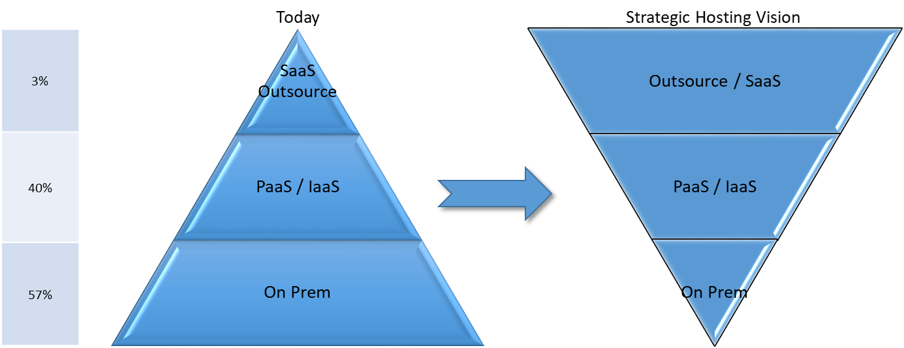
Multicloud Strategy
Architecture and the IT Heads will drive reengineering of application hosting
Our aim is to remove all our business applications & software products from internal data centres by end 2023
We will adopt a Multi-cloud strategy and evaluate options (in preference order):
SaaS, Software as a Service, where the application, technical services and hardware are managed by the vendor
PaaS, Platform as a Service, where we manage the application on a cloud vendor’s technical services and hardware
IaaS, where we manage the application and technology services on a vendor’s hardware
EPICs will incorporate cloud migration whenever it makes sense to do so:
Each significant Solution Intent will assess cloud migration opportunities and recommend an option
Solution Intent formal sign-off will embed cloud migration into our projects
Architecture will maintain an management dashboard showing our overall hosting status and progress toward our 2022 goal
Migration options:
Commercial of the Shelf packages (COTS) will be migrated to vendor supported SaaS whenever economically viable:
Vendor is best placed to optimise their own application for Cloud
Future upgrades become the responsibility of the vendor
Architecture work with application owners & vendor management to evaluate SaaS offering maturity (e.g. FactSet, IHS Market)
Applications that depend on a technology will be migrated to the PaaS platform for that technology (e.g. Azure for Microsoft technologies)
Fastest time to market
Native to original design, upward compatible with no code rewrite
Key differentiating and new strategic developments will be maintained on IaaS platforms hosted in AWS

Slide 21


Strategies for adopting the cloud
Transition to Cloud
2
There are six core industry strategies we can deploy to move from our capabilities and applications to the cloud. It’s important to recognize that each local business unit will have to evaluate their own capabilities and will deploy a mix of the six strategies.
Each local business needs to evaluate their capabilities alongside the strategic objectives of “Manage for Value, Drive for Growth and Scale up for the Future”.
Those capabilities which are important to growth, innovation and scale will typically be refactored or re-platformed, those in the manage for value strategy will likely be re-hosted or re-purchased.
Retire | This is where the business capability is no longer required for various reasons and therefore we simply seek to stop offering it.
Re-Purchase | This is where we seek an outside provider to supply us with this business capability. Whilst this gets the capability off the data center it also means the capability is not moving onto our public cloud.
Retain | This is the choice to keep a capability within the data centers. AGT is likely to outsource remaining data centers resulting in a forced “Re-purchased”
Re-host | Sometimes referred to as “lift and shift” this is where the capability is replicated on the new platform. This is often the quickest rout to get a capability onto the cloud but severely limits the benefits of the cloud.
Re-platform | This is a middle ground between re-host and re-factor. Rather than fully recreating the capability to be cloud native smaller changes are made to get
Re-factor | This is where the capability is fully redeveloped into a cloud native solutions. Which results in a longer transfer time but does give the full benefit of a cloud capability.
Increasing complexity, effort and reward

Slide 22
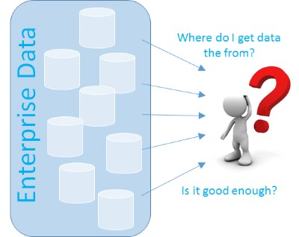
Data Strategy Reference Architecture
System of Record versus Source of Truth
To answer questions on how data should be sourced, it’s important to differentiate between Systems of Record and Sources of Truth. The full versions of the End-State diagrams show this.
System of Record (SOR):
A system of record is the authoritative data source for a given data element or piece of information.
Stating it a bit differently, it is the data repository where the data object, as a whole or specific attributes of a data object, are maintained. This maintenance includes data creation, updating, modifying and deleting.
Source of Truth (SOT):
The source of truth is a trusted data source that gives a complete picture of the data object as a whole.
SOR/SOT mapped on some systems in the reference architecture:
Global Data Store = SOT for all data domains
Markit EDM (MDM capability) = SOR for specific data domains, master & ref data
Markit EDM (ODS* capability) = SOT for positional data
PAM/SimCorp Dimension/Citi = SOR for positional data
* = Operational Data Store for storing positions and transactions
Data Strategy
Notes:
https://www.linkedin.com/pulse/difference-between-system-record-source-truth-santosh-kudva

Slide 23
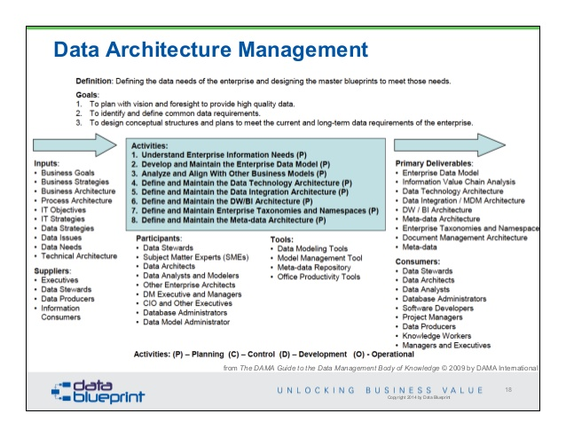

Slide 24
Objective (OLD)
Improve all of the ways to capture, store, manage, share and use data
Use
Leverage AI and advanced analytics to create value for customer and organization
Share
Offer maximal access to data while having the proper control framework in place (incl. ethics) to avoid mis-use of data
Business steers data priorities
Manage
Manage the data as an asset balancing offensive and defensive side : Data governance, data management, security and privacy
Data enables the business
Store
Provide a flexible infrastructure for all data to ensure easy access to data and easy way to add data
Capture
Capture broad range of data (first, second and third and ensure that this not a by-product of processes or solutions

Slide 25
Types of data
Data usage varies as it flows through the value chain
IBOR
ABOR
Lake
TSDB
Provider | Front Office Partner(s) | Back Office Partner(s) | Home grown AWS technologies
Function | Investment book of records | Accounting book of records | Raw data pool | Time series database
Audience | Front Office & Risk | Operations | Business Intelligence | Performance & Reporting
Type | Traded positions | Settlement positions | Unstructured (big) data | Historical data
Purpose | Allows portfolio managers to see their portfolio start of day holdings & cash and real time changes as decisions are made | Allows AAM to prove its compliance with regulations and accounting standards | Allows IM professionals to consume data for their own analysis | To show how data has change over time
Features | Real time position updating | Calculates NAV according to rules (e.g. UCITS, IFRS) | Unstructured data objects | Stores data in date/time stamp sequence
Timeliness | T | T+1 | T+1 | T+1 onward
Coverage | Strategies, Portfolios | Client, Seg. Mandate, Fund & subfund | Any data class | Benchmarks, holdings, prices

